Slide 1
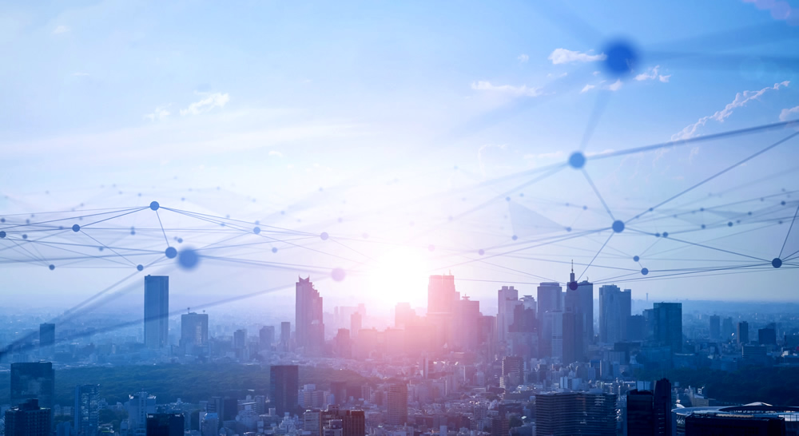
PYRamid level
Subline
Date 09/13/2022
Name: NGUYEN LE KHAC ANH
Nguyen quang hung
R-car vision 2, soc sw,
VISION IP
Renesas Electronics Corporation

Slide 2
Agenda
Overview Page 00
Frame Transformation Page 00
Coarse flow and Fine flow estimation Page 00
Backward and Forward flow field Page 00
Down-sampling and Up-sampling Page 00
Decoder – Tag and Encoder Page 00
Fusion Page 00

Slide 3
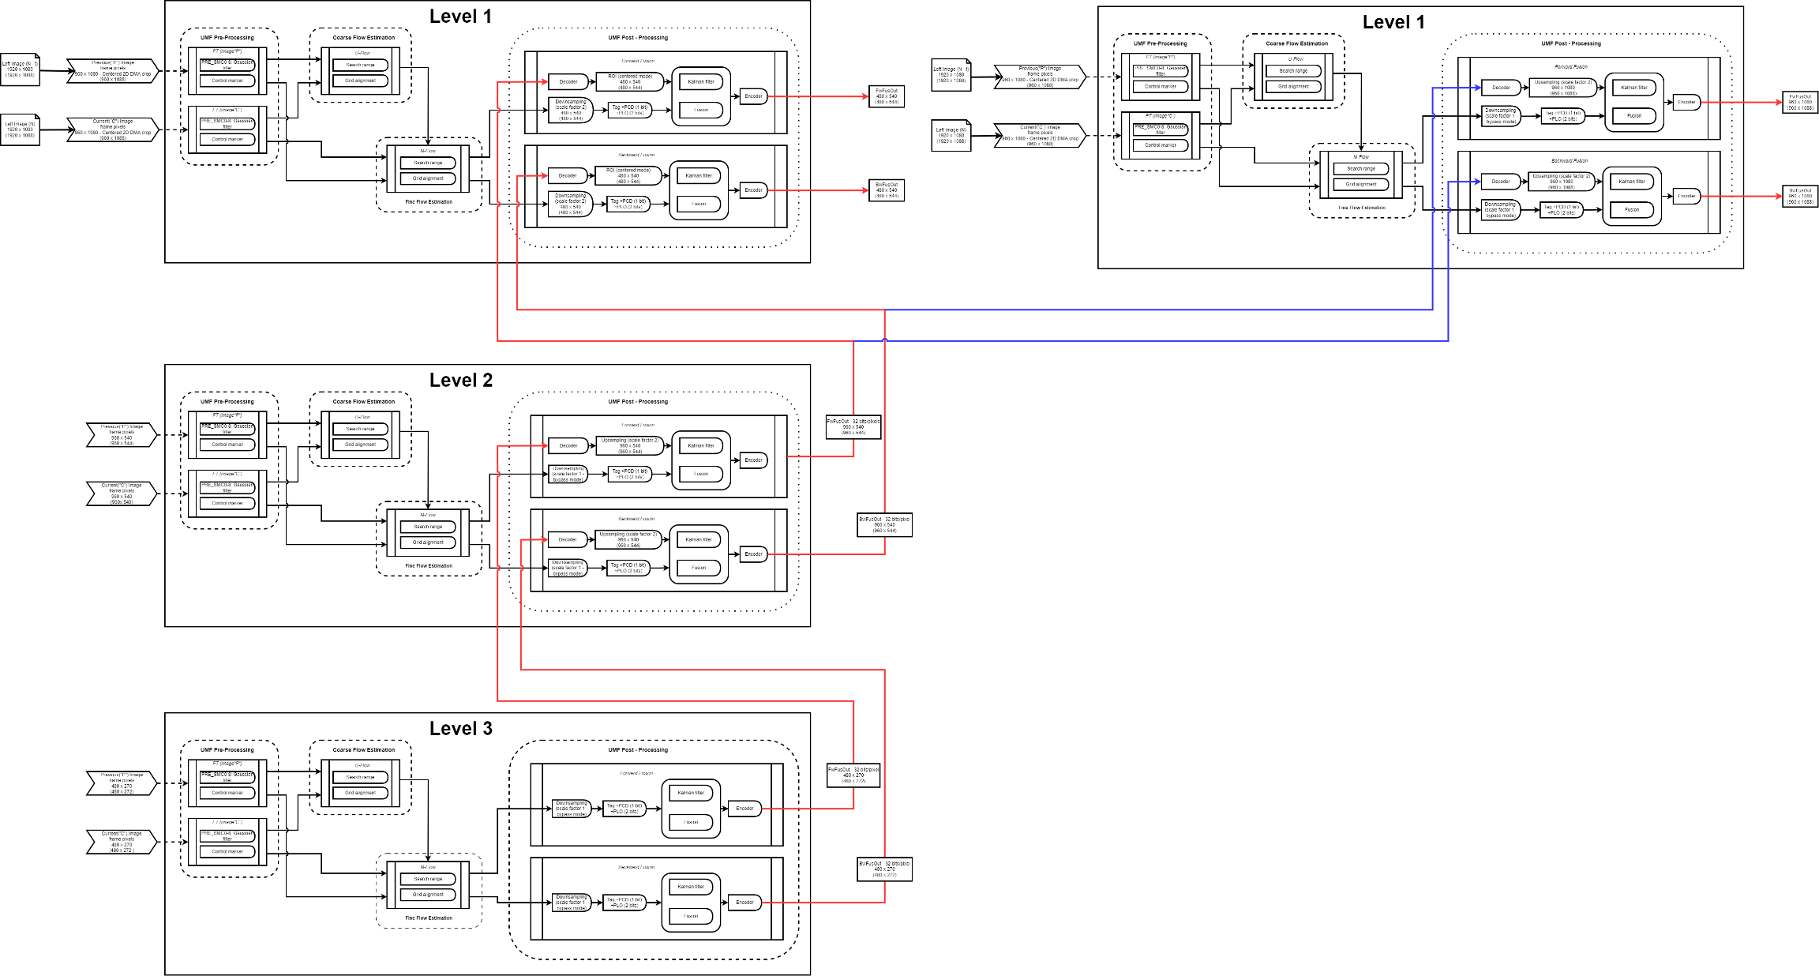
Level Pyramid Diagram

Slide 4
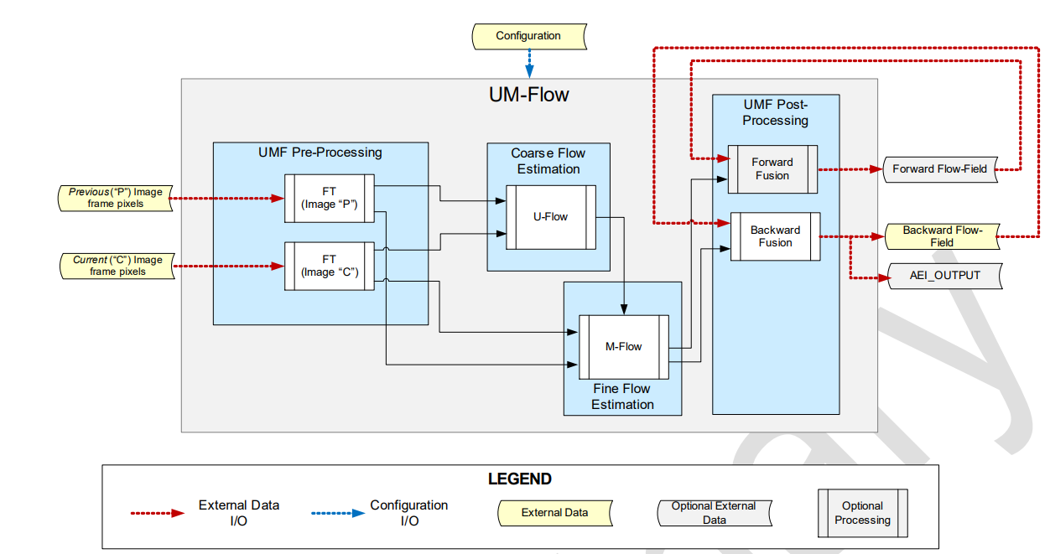
Overview
The UMF_CORE is designed in order to sequentially support optical flow estimation on different resolution levels of the same pairs of input images

Slide 5
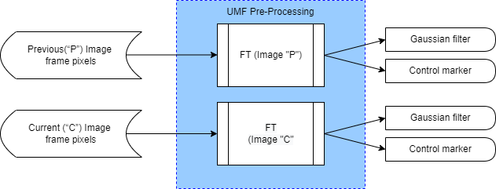
Frame Transformation
Frame transformation (FT) contains two identical blocks: FT_P is dedicated to process the previous
image frame, and FT_C is dedicated to process the current image
Feature: Smooth filtering of gray images

Slide 6
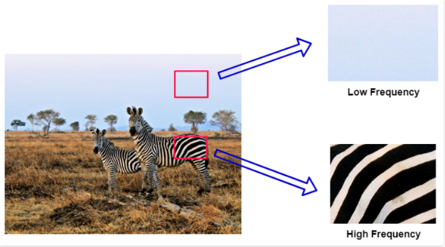
Frame Transformation
A Gaussian Filter is a low-pass filter used for reducing noise (high-frequency components) and blurring regions of an image.

Slide 7
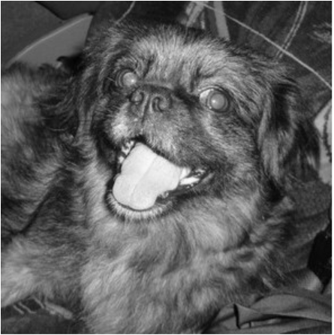
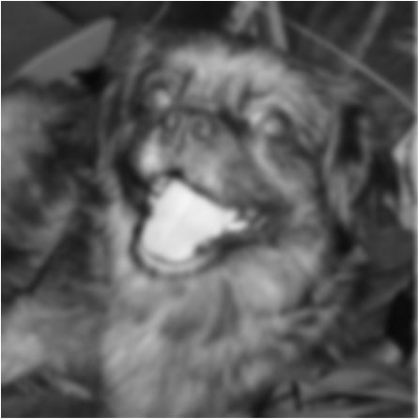
Frame Transformation
A Gaussian Filter is a low-pass filter used for reducing noise (high-frequency components) and blurring regions of an image.
Original
Smooth

Slide 8
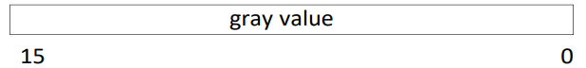
The Gaussian FILTER
A 3x3 kernel filter with programmable coefficients is applied to the input gray image data
The input image consists of maximum 16 bits per pixel. In case of 12 bits/pixel, the 4 MSBs are unused. The programmable values of the filter coefficients PRE_SMC0-8 are 0, 1, 2, 4 and 8
Recommended coefficients values are
[0 0 0 0 1 0 0 0 0] : no smoothing
[1 2 1 2 4 2 1 2 1] : Gaussian filter
[1 1 1 1 1 1 1 1 1] : Box filter
1 | 2 | 1
2 | 4 | 2
1 | 2 | 1
3x3 kernel filter:

Slide 9
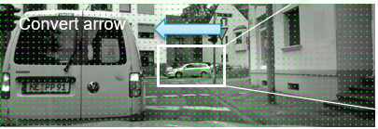
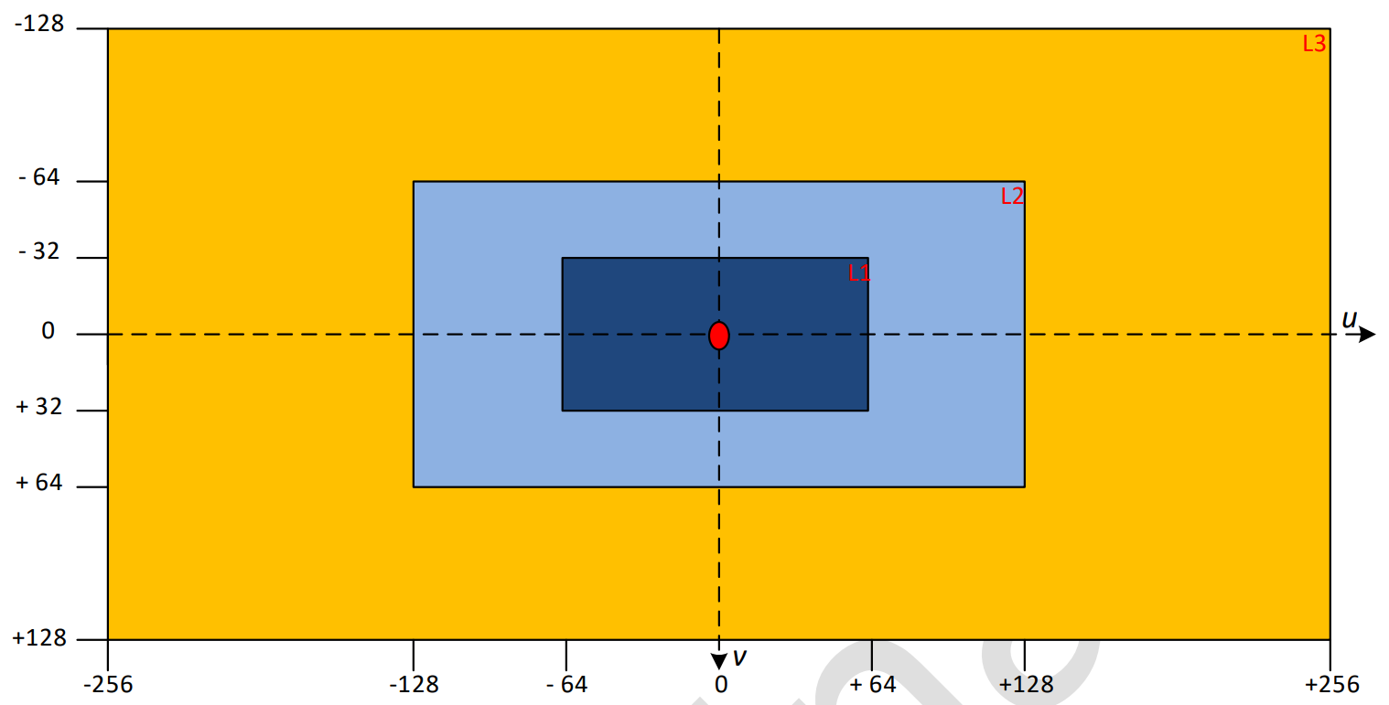
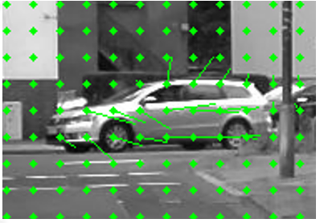
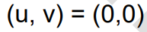
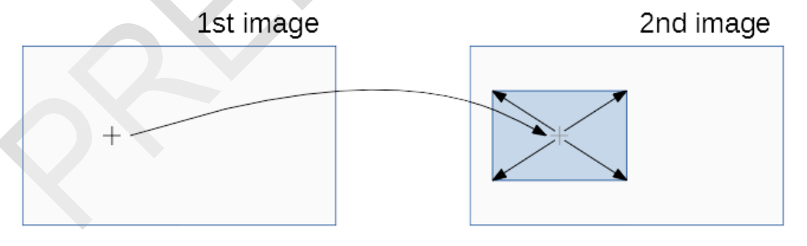
Coarse Flow Estimation – Fine Flow Estimation
Grid alignment
Seach range

Slide 10
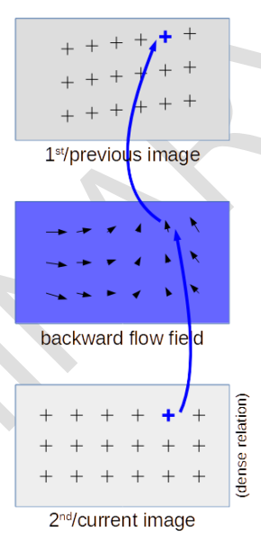
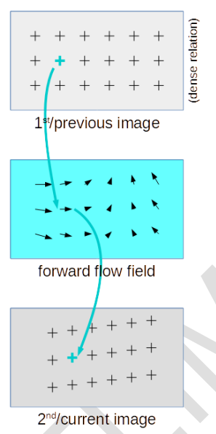
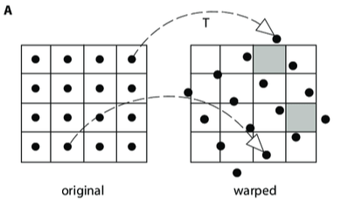
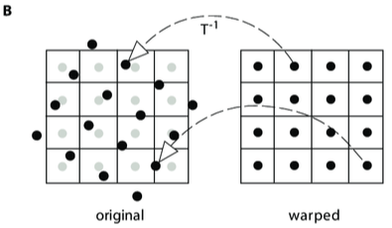
Backward & Forward Flow Field
Backward flow field
Forward flow field

Slide 11
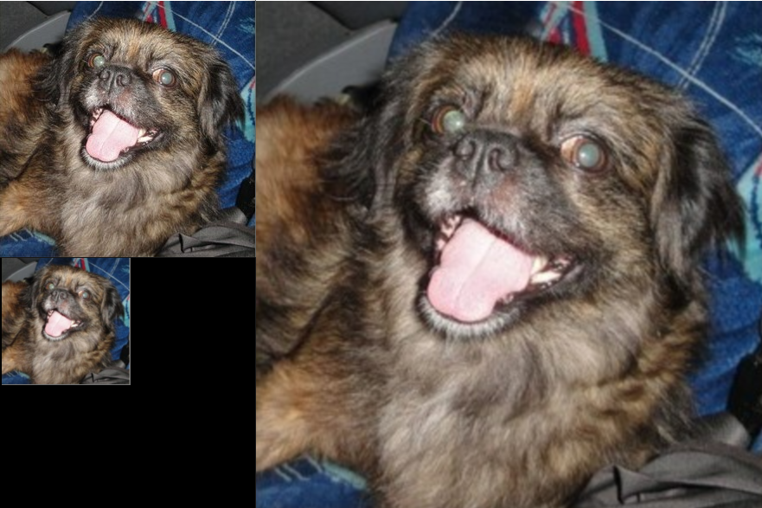
Down-sampling and Up-sampling
The Gaussian Pyramid:
A representation in multiple scales
The goal is to define a representation in which image information at different scales is explicitly available

Slide 12
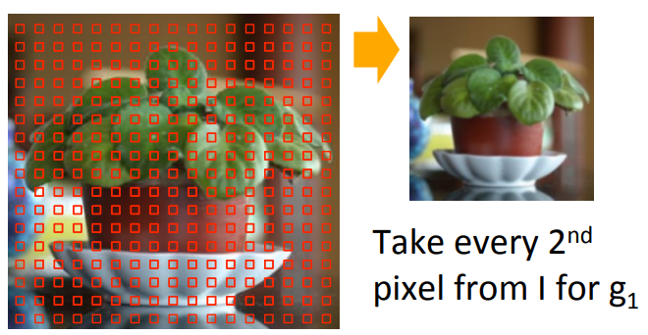
Down-sampling and Up-sampling
Down-sampling and Up-sampling in DOF use the Gaussian pyramid method
Down-sampling
1 | 2 | 3 | 4 | 5 | 6
7 | 8 | 9 | 10 | 11 | 12
13 | 14 | 15 | 16 | 17 | 18
19 | 20 | 21 | 22 | 23 | 24
25 | 26 | 27 | 28 | 29 | 30
31 | 32 | 33 | 34 | 35 | 36
1 | 3 | 5
13 | 15 | 17
25 | 27 | 29
Notes:
It makes the data of a more manageable size
Reduces the dimensionality of the data thus enabling in faster processing of the data (image)
Reducing the storage size of the data

Slide 13
Down-sampling and Up-sampling
Down-sampling and Up-sampling in DOF use the Gaussian pyramid method
Up-sampling
1 | 1 | 3 | 3 | 5 | 5
1 | 1 | 3 | 3 | 5 | 5
13 | 13 | 15 | 15 | 17 | 17
13 | 13 | 15 | 15 | 17 | 17
25 | 25 | 27 | 27 | 29 | 29
25 | 25 | 27 | 27 | 29 | 29
1 | 3 | 5
13 | 15 | 17
25 | 27 | 29
Notes:
It makes the data of a more manageable size
Reduces the dimensionality of the data thus enabling in faster processing of the data (image)
Reducing the storage size of the data

Slide 14
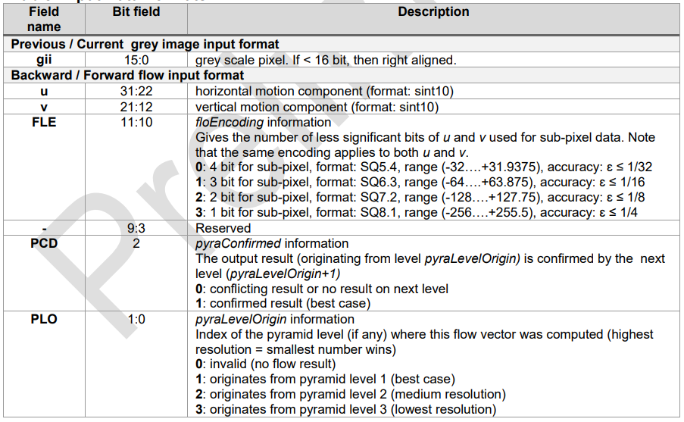
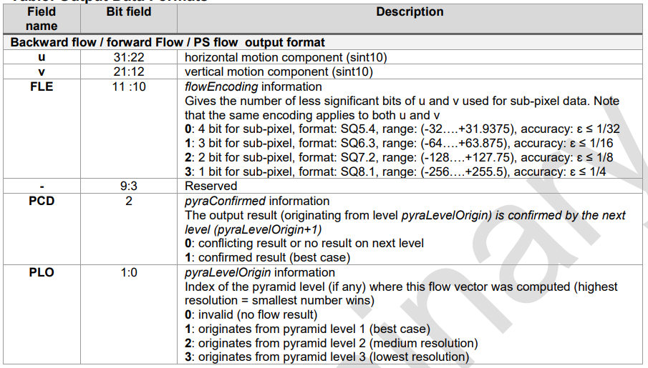
Decoder – Tag (PCD + PLO) - Encoder
Input data formats
Output data formats
Decoder: The FUSION Decoder module decompresses, 10 bits each for U and V components, 2 bits for the flow encoding(FLE), 2 bits for pyramid level(PLO)and 1 bits for quality measure(PCD) by the Low Priority. The decompressed values are derived depending on the value of FLE by shifting both values by FLE bits to the left, the two FLE bits are then removed from the output.
Encoder: the pixel data is encoded back to the 32-bit compressed format used at the Path A input interface.

Slide 15
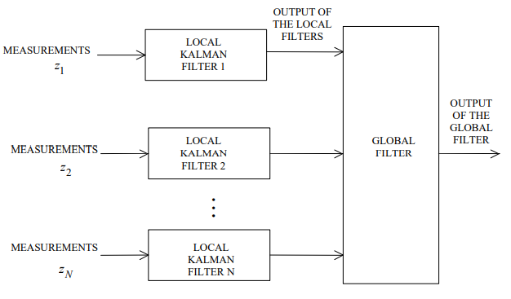
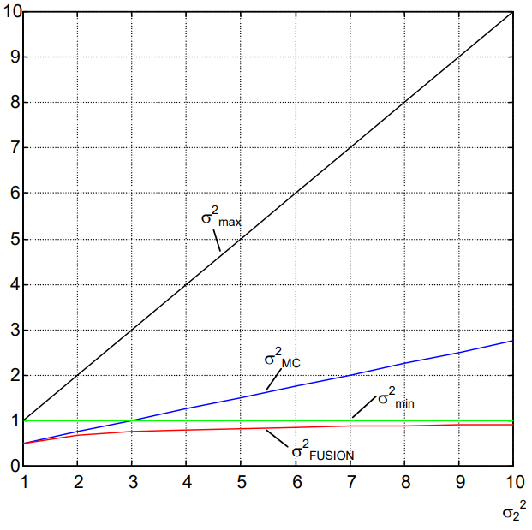
Fusion
The FUSION module gets 2 flow-field estimate frames, and combines them into one resulting flow-field estimate frame, according to pixel based criteria, i.e., the output value is based locally only on the respective input values, not on their surrounding estimate values
Evolution of the different variances
Decentralized Kalman filter

Slide 16
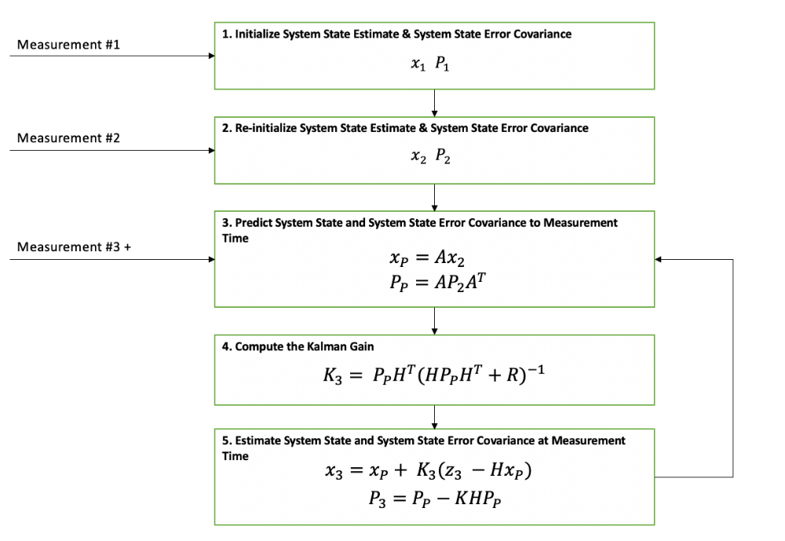
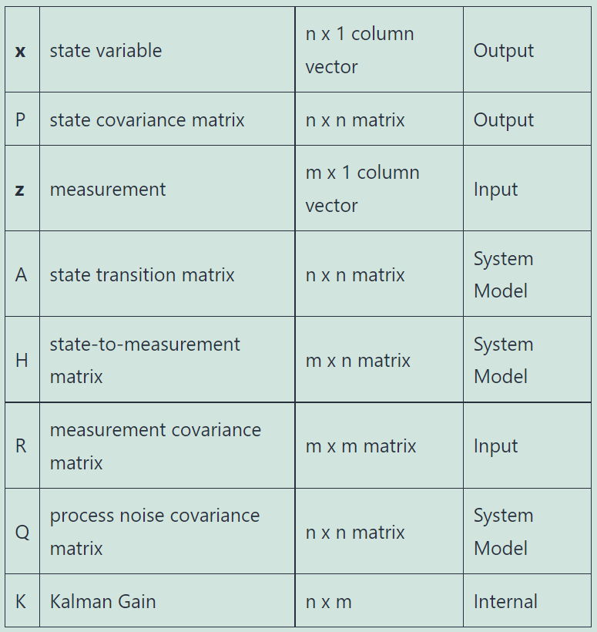
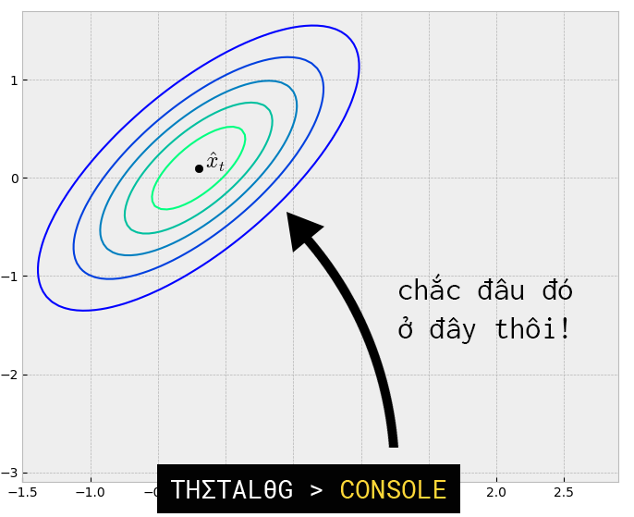
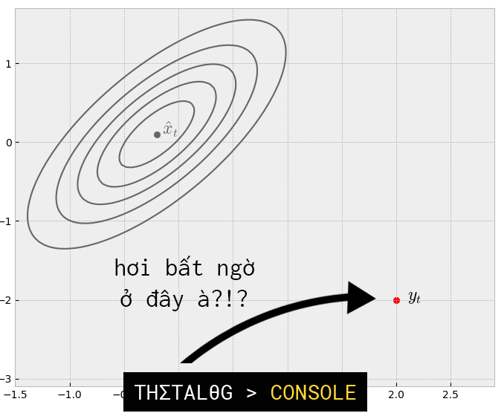
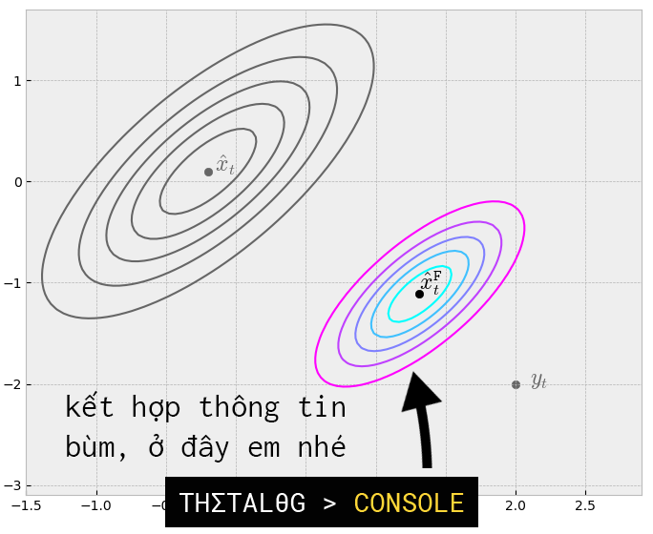
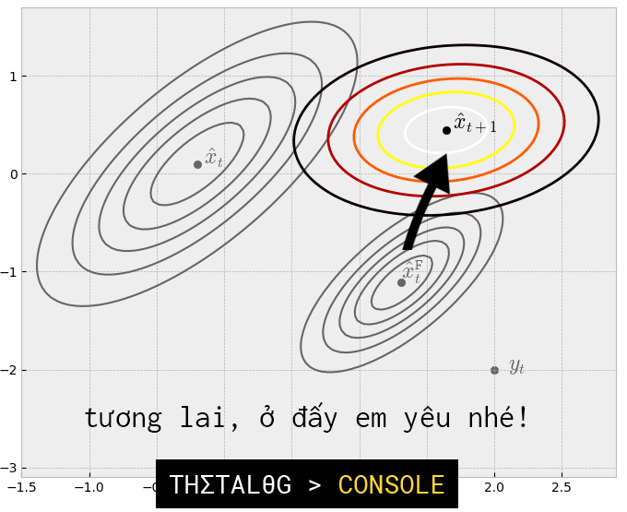
Kalman Filter
+ Q

Slide 17
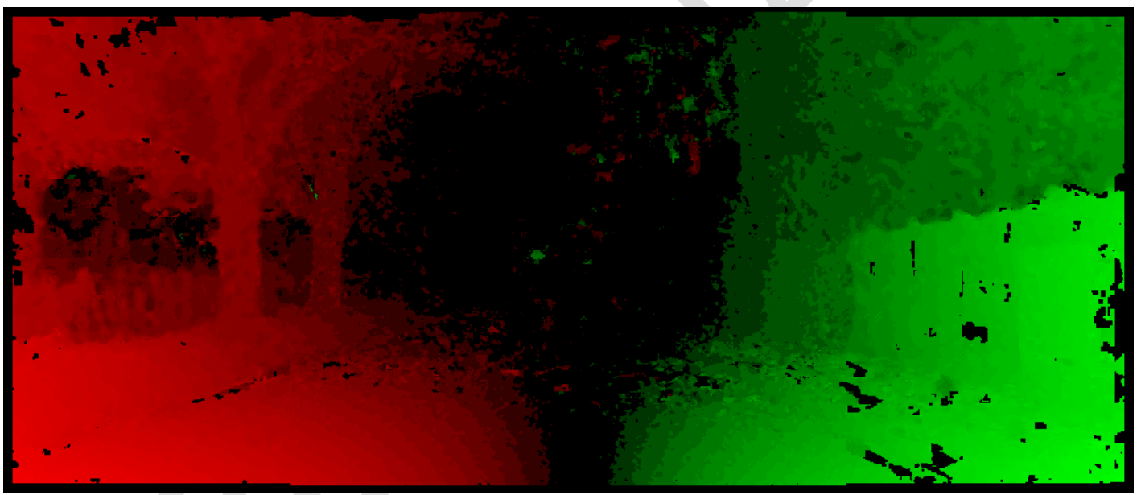
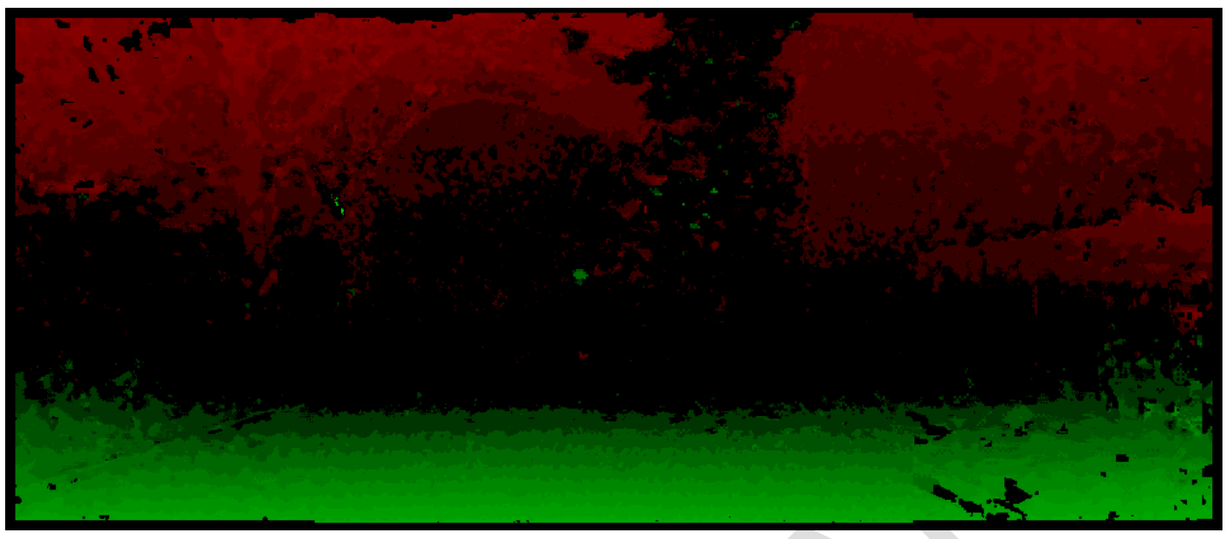
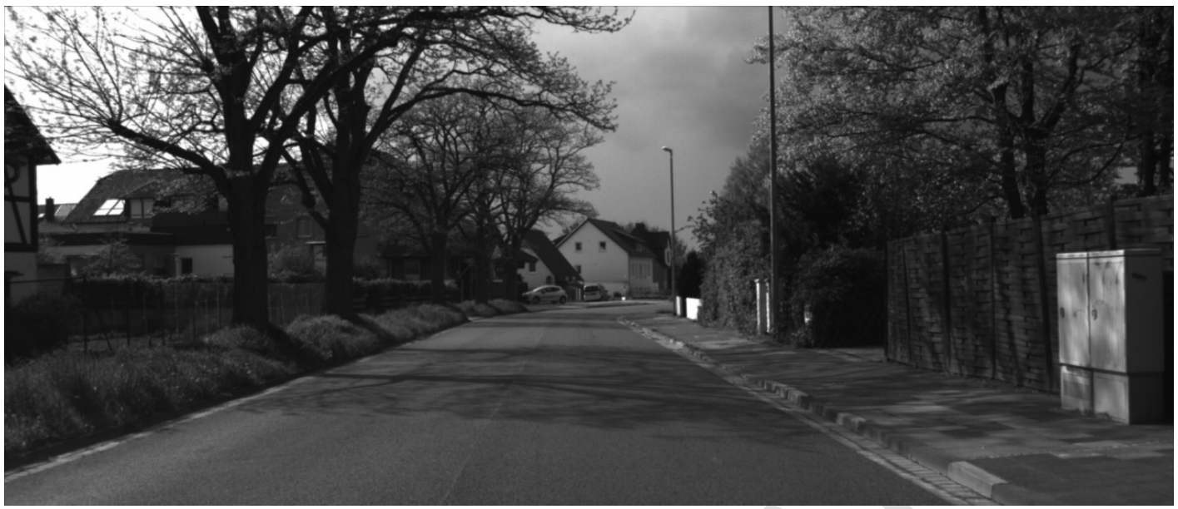
Dense Optical Flow OUTPUT
Flow field horizontal
Flow field vertical
Real world scenario
Single component flow fields
Red: negative component values with the brightness referring to the magnitude of the component
Green: positive component values with the brightness referring to the magnitude of the component

Slide 18
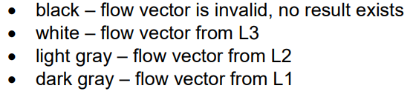
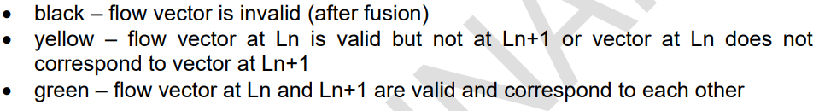
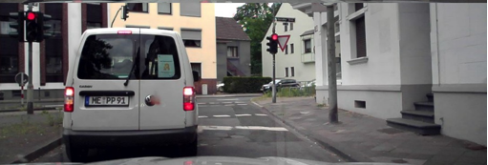
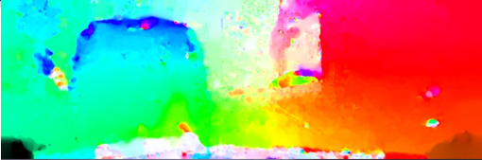
Dense flow map result
Level maps(PLO)
Confirmation maps(PCD)

Slide 19
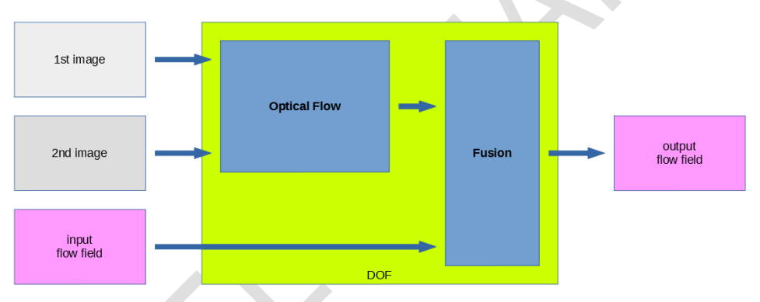
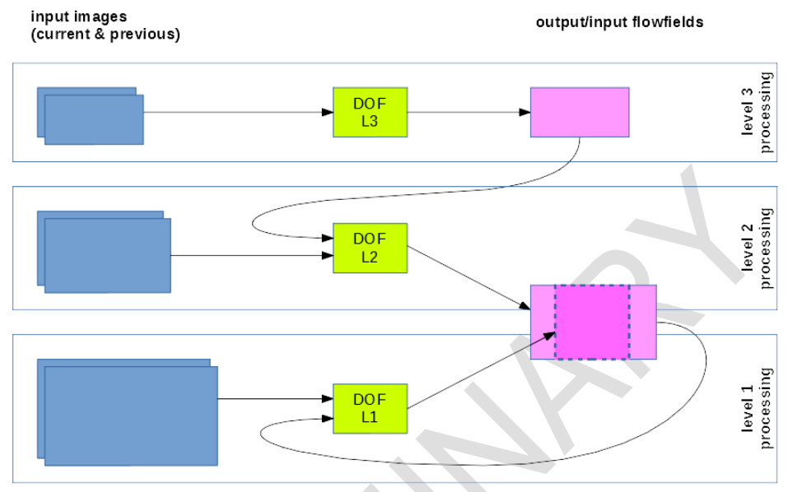
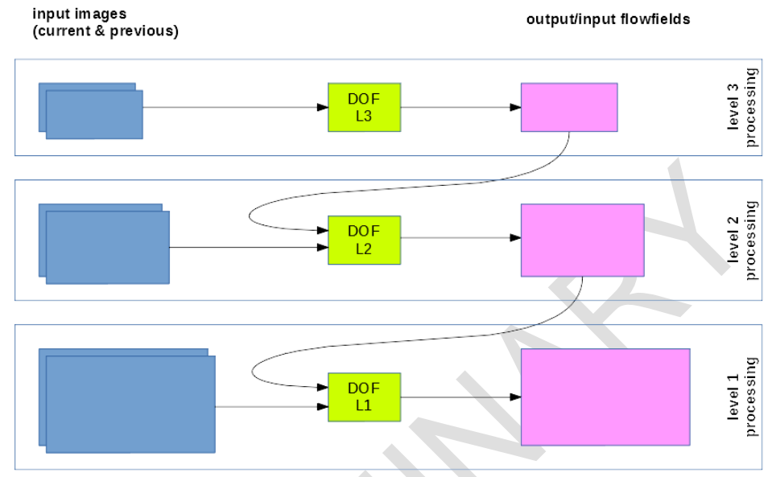
Summary
Optical flow and fusion
No dedicated L1 flow field buffer, with L1 to L2 downscaling
Separate buffers, no L1 to L2 downscaling

Slide 20
target application and algorithm
High Speed Appli.
30-130km/h
Low Speed Appli.
0-80(130)km/h
Highway Pilot (HWP)
Speed
Target application
Lane Departure Warning(LDW)
Lane Keep Assist(LKA)
Lane Change Assist(LCA)
Autonomous Emergency Brake (AEB)
Forward Collision Warning (FCW)
Traffic Sign Recognition (TSR)
Intelligent Speed Assist (ISA)
High Beam Assist (HBA)
Traffic Jam Assist (TJA)
Night Vision(NV)
Traffic Signal Detection (TSD)
HUD Appli.
0-80km/h
Lane maker
Traffic Sign Recognition (TSR)
Traffic Signal Detection (TSD)
Auto Parking Appli.
0-20km/h
Auto Parking (APK)
Parking Area Detection (PSD)
Surround Monitoring System (SMS)
Performance
Base algorithm
Deep Planning
Random forest
Grid base SLAM
Dense-Stereo
Dense Optical-Flow
Latent-SVM/DPM/Latent-CNN-Depp leaning
Kalman-filter
TSR
Fusion
Planning
Clustering
Structure from motion
“Light”-Dense Optical-Flow
(Visual) Ego-Motion
CNN-Deep leaning
Weak classifier (HOG,Hough)

Slide 21
Data flow
“Light”-Dense
Optical-Flow
(Visual) Ego-Motion
Strong classifier
Tracking & environment
modeling
Planning
Camera
Structure from motion
Clustering
CNN-Deep leaning
Fusion
Planning
Mono camera
Weak classifier
(HOG,Hough)
TSR
Kalman-filter
Stereo camera or High end mono camera
“Light”-Dense
Optical-Flow
(Visual) Ego-Motion
Strong classifier
Tracking & environment
modeling
Planning
Left
Camera
CNN-Deep leaning
Structure from motion
Clustering
Fusion
Planning
Right
Camera
TSR
Weak classifier
(HOG,Hough)
Kalman-filter
[Option]
Latent-SVM/ CNN(DPM)
Dense-
Optical-Flow
Reliability
function
Grid base SLAM
Deep Planning
Random forest
Dense-
Stereo
Reliability
function

Slide 22
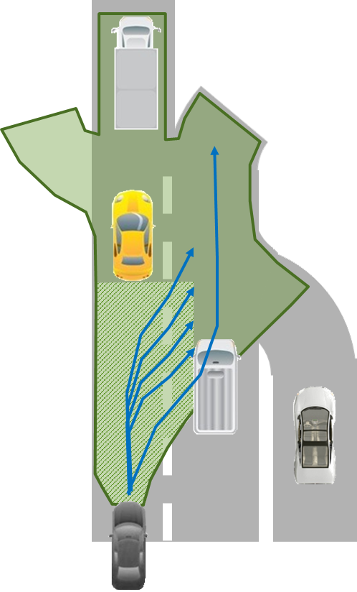
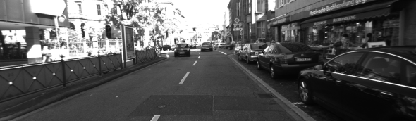
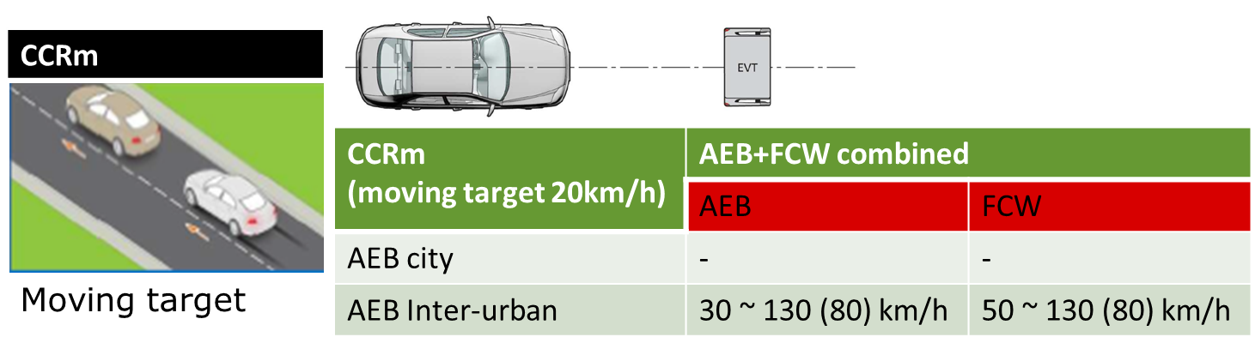
Why need dense level ?
Vehicle control in sensitive scene
Become a very attractive sensing technique
for obtaining 3D information
3D information keep criteria targeted 130km/h

Slide 23
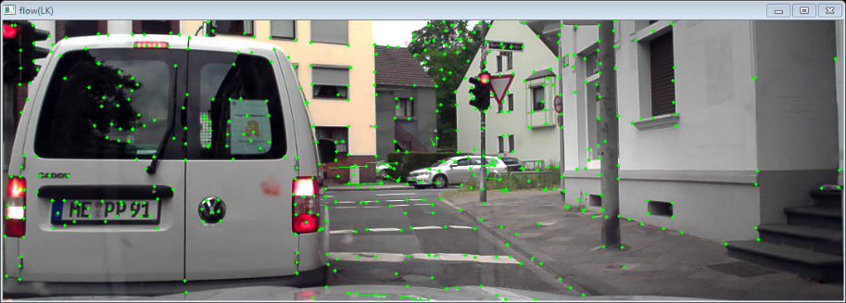
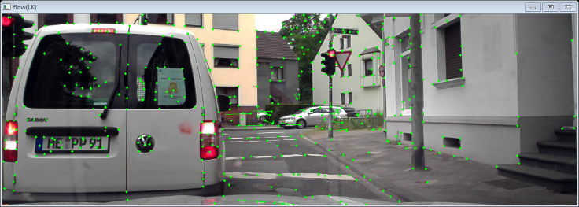
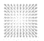
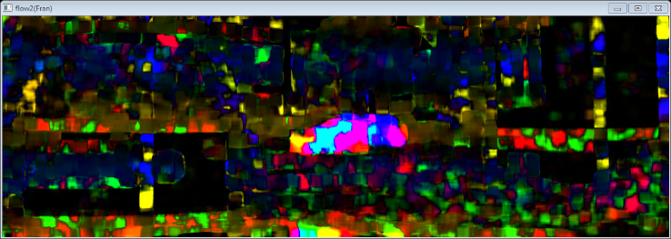
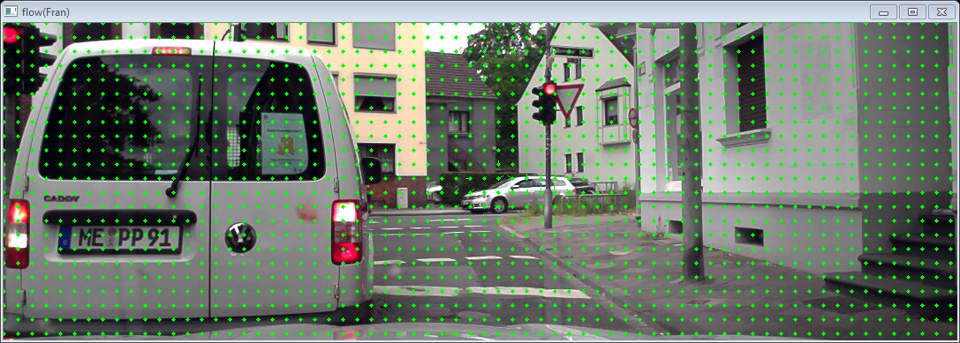



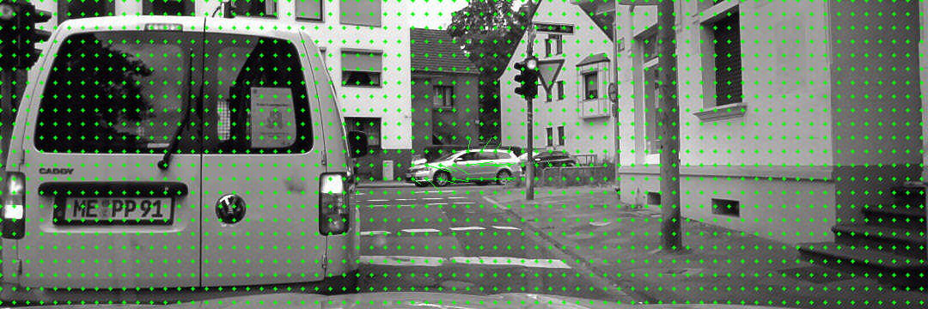
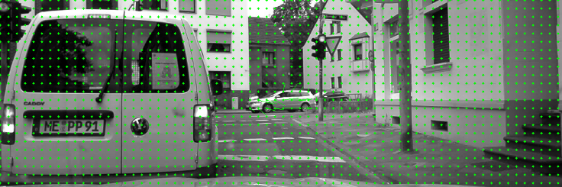
Compare Dense to Sparse
Sparse
LK
Farneback
Flow Map
Convert arrow
Dense
Renesas
(TVL1 base)
Flow Map
Convert arrow

Slide 24
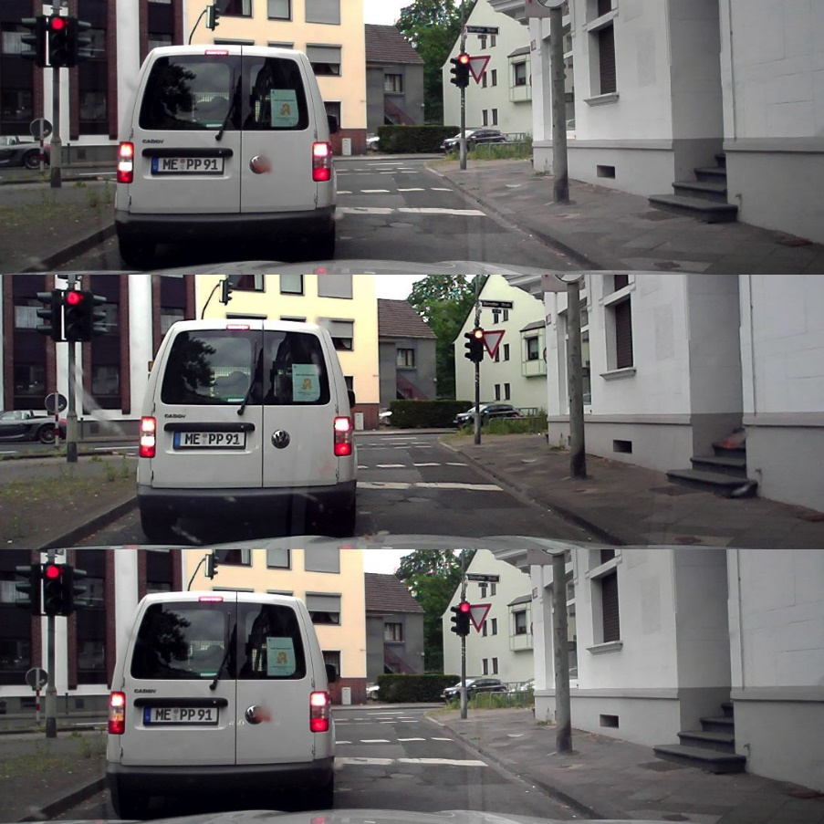

Dense Map
IP | Target | Criteria
Dense-Optical-Flow | 2Mpix 16ms | 0-130Km/h High speed pilot
Dense-Stereo | 2Mpix 33ms | 0-130Km/h High speed pilot
Simulation result
Renesas Dense Map
Left image
Disparity map
0
128
Disparity
Right image
Flow map
Flow
+
Left +T image
Hazard map
min
max
Level

Slide 25

Dense Map Simulation Demonstration

Slide 26
Headline
Subline

